Slide 1


Microservices Architecture
Microservices Architecture Introduction
Introduction to MS

Slide 2
Microservices Architecture
Agenda
What is Monolithic?
What are Microservices?
Why are Microservices ?
Microservices Development
Microservices Deployment
Microservices Patterns

Slide 3
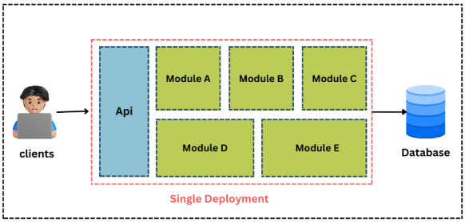
Microservices Architecture
What is Monolithic ?
Monolithic architecture is the traditional structure for software applications.
Monolithic is an all-in-one architecture, wherein all aspects of the software operate as a single unit.
Monolithic

Slide 4
Microservices Architecture
Monolith Technologies
Application Server
Web Container
Logic Container / spring core container
Soap WS technology
J2EE framework
XML format
Monolithic

Slide 5
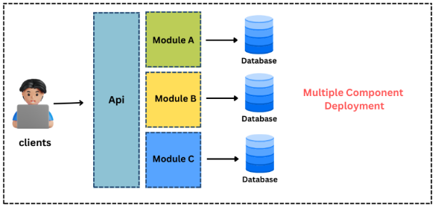
Microservices Architecture
What are Microservices?
Microservices are an architectural style that structures an application as a collection of small, autonomous services modeled around a business domain.
Microservices

Slide 6
Microservices Architecture
What are Microservices?
Each service is self-contained and implements a single business capability.
Services communicate over a network, typically via HTTP/REST or messaging queues.
Services are independently deployable and scalable.
Microservices

Slide 7
Microservices Architecture
Microservices Technologies
Kubernetes + Dockers
Web Container
Spring Core Container
Restful API technology
Spring framework
JSON/XML/PDF/HTML Format
Microservices

Slide 8
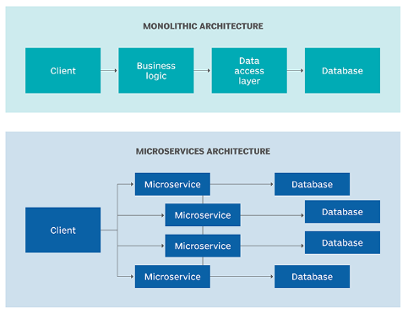
Microservices Architecture
Monolithic VS. Microservices
Microservices

Slide 9
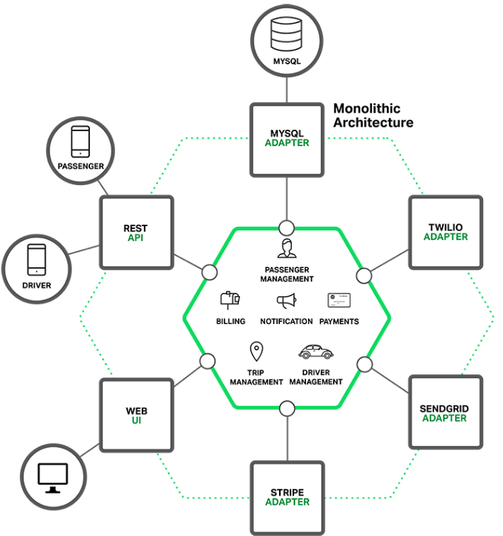
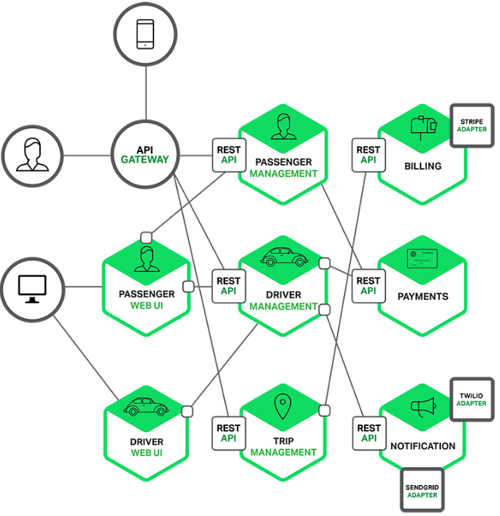
Microservices Architecture
Monolithic VS. Microservices

Slide 10
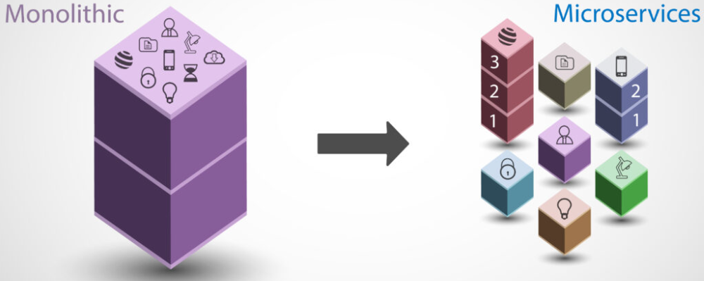
Microservices Architecture
Why Microservices?
Microservices

Slide 11
Microservices Architecture
Why Microservices?
Scalability
Horizontal Scaling: Microservices allow individual components to scale independently based on demand.
Optimized Resources: Allocate resources specifically to the parts of the application that need them most.
Microservices
Flexibility and Technology Diversity
Polyglot Persistence: Use different storage technologies based on specific service requirements.
Polyglot Programming: Different microservices can be developed using different programming languages or frameworks.

Slide 12
Microservices Architecture
Why Microservices?
Improved Fault Isolation
Failure Containment: Issues in one microservice are less likely to affect others.
Resilience: Implement strategies like circuit breakers to enhance fault tolerance.
Microservices
Faster Time to Market
Independent Development: Teams can work on different services simultaneously without waiting for a centralized codebase.
Continuous Deployment: Deploy changes to individual microservices without affecting the entire system.

Slide 13
Microservices Architecture
Why Microservices?
Better Organization Around Business Capabilities
Domain-Driven Design: Services are modeled around business domains, making them easier to understand and maintain.
Cross-Functional Teams: Each team can own and manage a microservice from development to deployment.
Microservices
Easier Maintenance and Evolution
Smaller Codebases: Each microservice has a smaller, more manageable codebase.
Incremental Updates: Update, replace, or rewrite individual services without a complete system overhaul.

Slide 14
Microservices Architecture
Why Not Microservices?
Complexity
Operational Complexity: Managing many services introduces significant operational overhead.
Development Complexity: Requires coordination and management of inter-service
Microservices
Increased Resource Consumption
Overhead: Each microservice may require its own runtime environment, leading to higher resource usage.
Duplication: Common functionality might be duplicated across services, leading to inefficiency.

Slide 15
Microservices Architecture
Why Not Microservices?
Distributed System Challenges
Network Latency and Reliability: Increased number of network calls can lead to latency and potential reliability issues.
Consistency: Maintaining data consistency across distributed services can be challenging.
Microservices
Deployment and Monitoring Complexity
Continuous Integration/Continuous Deployment (CI/CD): Requires sophisticated CI/CD pipelines.
Monitoring and Logging: Requires comprehensive monitoring and logging solutions for tracking issues across services.

Slide 16

Microservices Architecture
Microservices Development
Design Principles
Single Responsibility-Each microservice should have a well-defined purpose and responsibility.
Loose Coupling-Minimize dependencies between microservices to enhance modularity.
High Cohesion-Group related functionalities within the same microservice.

Slide 17

Microservices Architecture
Microservices Development
Technology Stack
Programming Languages: Choose the right language for each service based on its requirements (e.g., Java, Python, Go).
Frameworks: Utilize frameworks that support microservices (e.g., Spring Boot, Micronaut, Django).
Containers: Use Docker or similar containerization technologies to package microservices.

Slide 18

Microservices Architecture
Microservices Development
API Management
RESTful APIs: Standard approach for communication between microservices.
gRPC: Consider for high-performance, low-latency communication.
API Gateway: Centralize API management, routing, and security.

Slide 19

Microservices Architecture
Microservices Development
Data Management
Database per Service: Each microservice should manage its own database to ensure data autonomy.
Event Sourcing: Use events to capture changes in state for complex data handling.

Slide 20
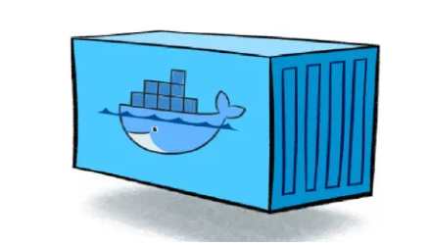
Microservices Architecture
Microservices Deployment
Containerization
Docker: Package microservices into Docker containers for consistent environments.
Container Orchestration: Use Kubernetes or Docker Swarm to manage containerized microservices at scale.

Slide 21
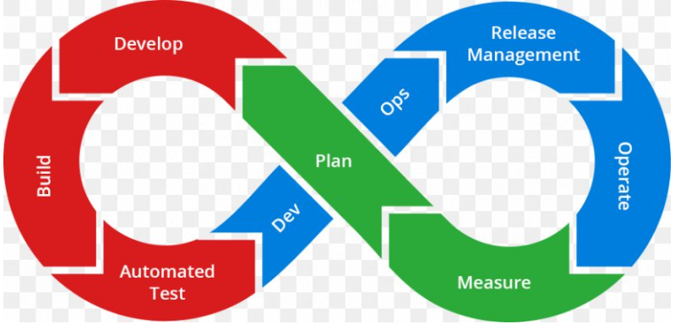
Microservices Architecture
Microservices Deployment
Continuous Integration –
Continuous Deployment
CI Tools: Automate builds and tests using Jenkins, GitLab CI/CD, Circle CI, or similar tools.
CD Pipelines: Implement deployment pipelines for automated, repeatable deployments.

Slide 22
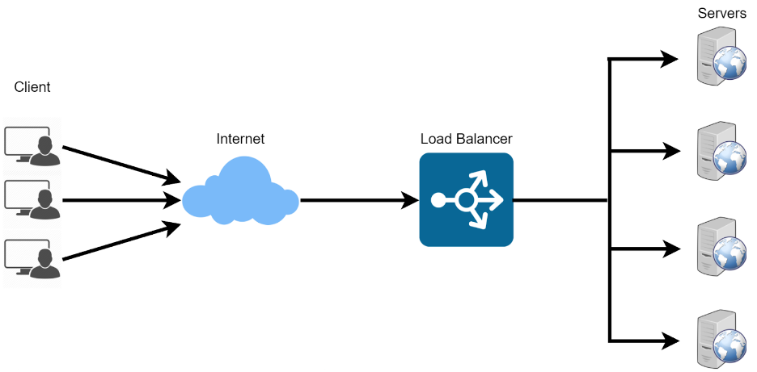
Microservices Architecture
Microservices Patterns
Load balancing
Description: Distributing incoming network traffic across multiple servers to ensure no single server becomes overwhelmed.
Benefits: Improves availability, fault tolerance, and performance.
Types:
Client-Side Load Balancing: The client determines the server to which it should send requests.
Server-Side Load Balancing: A central load balancer distributes requests to different servers.

Slide 23
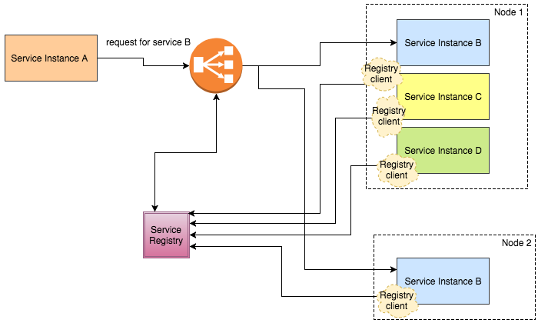
Microservices Architecture
Microservices Patterns
Description: Mechanism to dynamically detect and connect microservices within a network.
Benefits: Enables dynamic scaling, fault tolerance, and reduces configuration complexity.
Types:
Client-Side Discovery: Clients query the service registry to find available instances.
Server-Side Discovery: A load balancer or API gateway queries the service registry.
Service Discovery

Slide 24
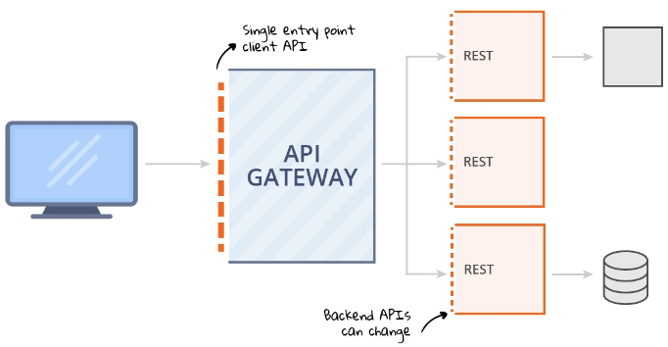
Microservices Architecture
Microservices Patterns
Description: A single entry point for all client requests, routing them to the appropriate microservice.
Benefits: Simplifies client interactions, enhances security, centralizes cross-cutting concerns (like logging, authentication), and provides load balancing.
API Gateway

Slide 25
Microservices Architecture
Thank You !!

